Slide 1
Trapezoidal Rule of Integration
by
Dr. Md. Rajibul Islam
CSE, UAP

Slide 2
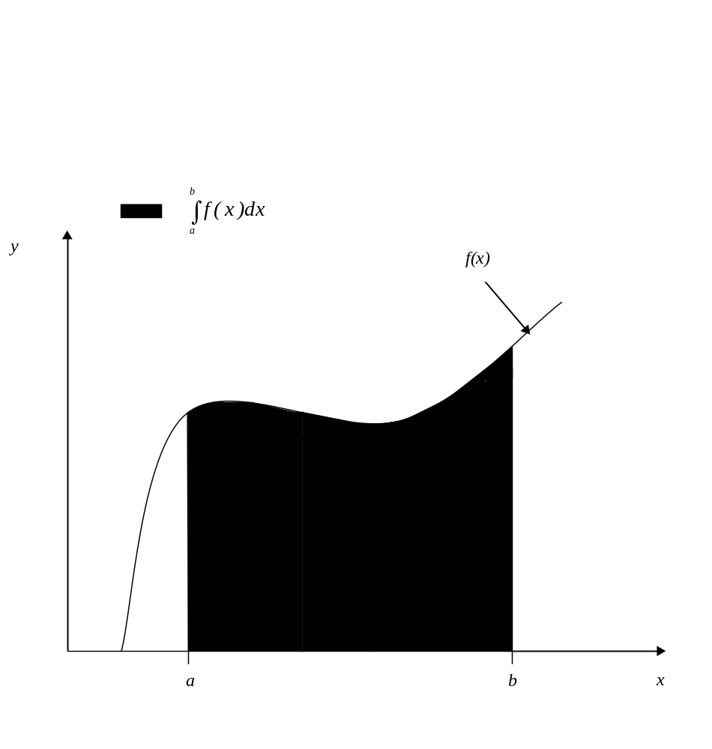
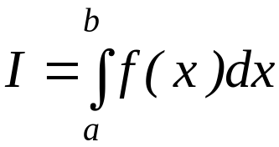
What is Integration
Integration:
The process of measuring the area under a function plotted on a graph.
Where:
f(x) is the integrand
a= lower limit of integration
b= upper limit of integration

Slide 3

Basis of Trapezoidal Rule
Trapezoidal Rule is based on the Newton-Cotes Formula that states if one can approximate the integrand as an n^{th} order polynomial…
where
and

Slide 4
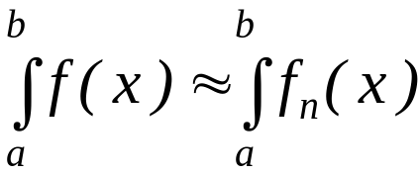
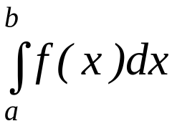
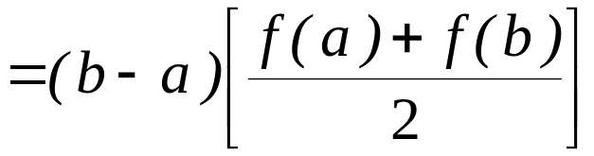
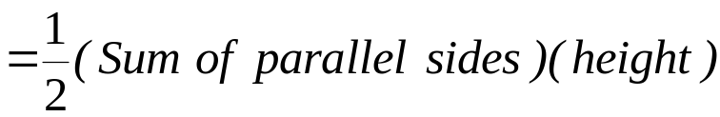
Basis of Trapezoidal Rule
Then the integral of that function is approximated by the integral of that n^{th} order polynomial.
Trapezoidal Rule assumes n=1, that is, the area under the linear polynomial,

Slide 5
Derivation of the Trapezoidal Rule

Slide 6
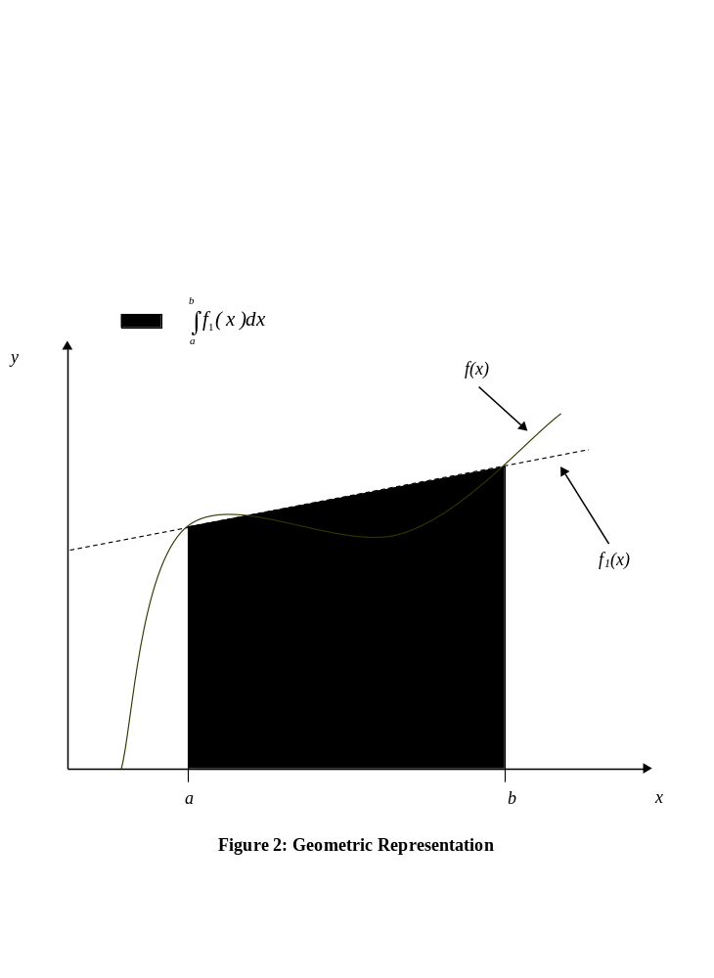
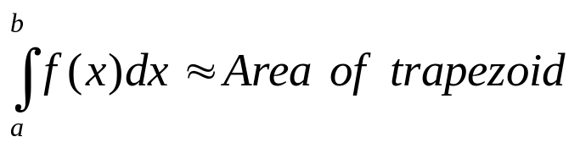
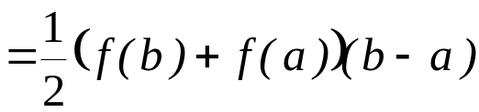
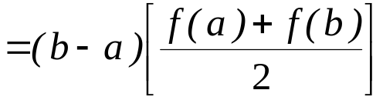
Method Derived From Geometry
The area under the curve is a trapezoid. The integral
Some approx. value of f in (a, b)

Slide 7
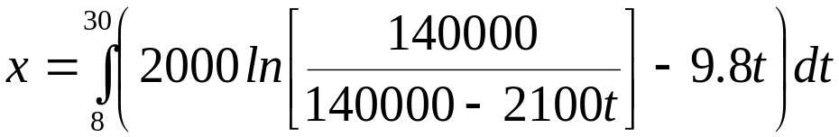


Example 1
The vertical distance covered by a rocket from t=8 to t=30 seconds is given by:
Use single segment Trapezoidal rule to find the distance covered.
Find the true error, for part (a).
Find the absolute relative true error, for part (a).

Slide 8
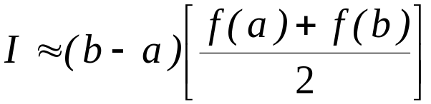


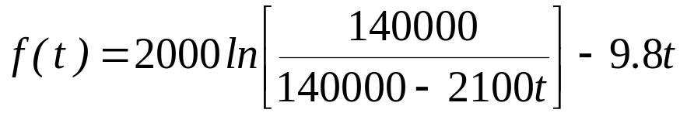
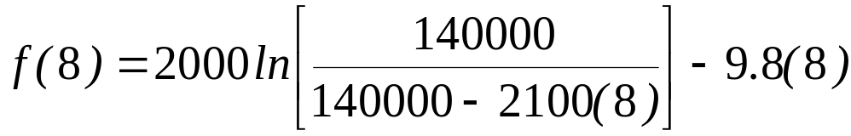

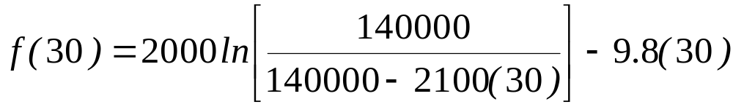

Solution
a)

Slide 9
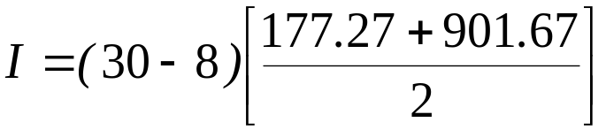


Solution (cont)
a)
b)
The exact value of the above integral is

Slide 10



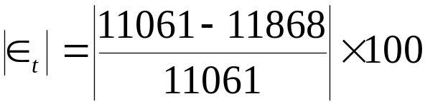

Solution (cont)
b)
c)
The absolute relative true error,
, would be

Slide 11
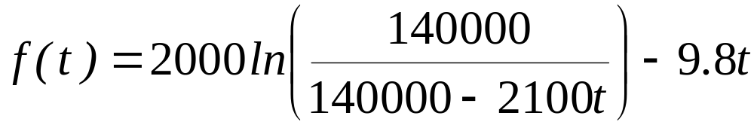
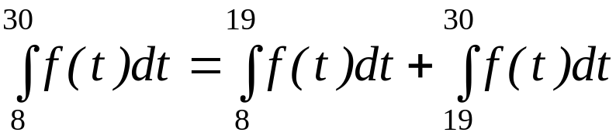
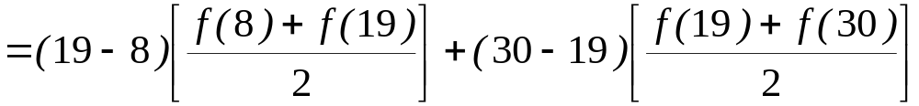
Multiple Segment Trapezoidal Rule
In Example 1, the true error using single segment trapezoidal rule was large. We can divide the interval [8,30] into [8,19] and [19,30] intervals and apply Trapezoidal rule over each segment.

Slide 12



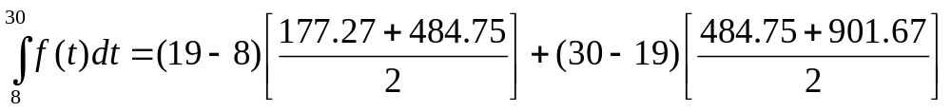

Multiple Segment Trapezoidal Rule
With
Hence:

Slide 13


Multiple Segment Trapezoidal Rule
The true error is:
The true error now is reduced from -807 m to -205 m.
Extending this procedure to divide the interval into equal segments to apply the Trapezoidal rule; the sum of the results obtained for each segment is the approximate value of the integral.

Slide 14
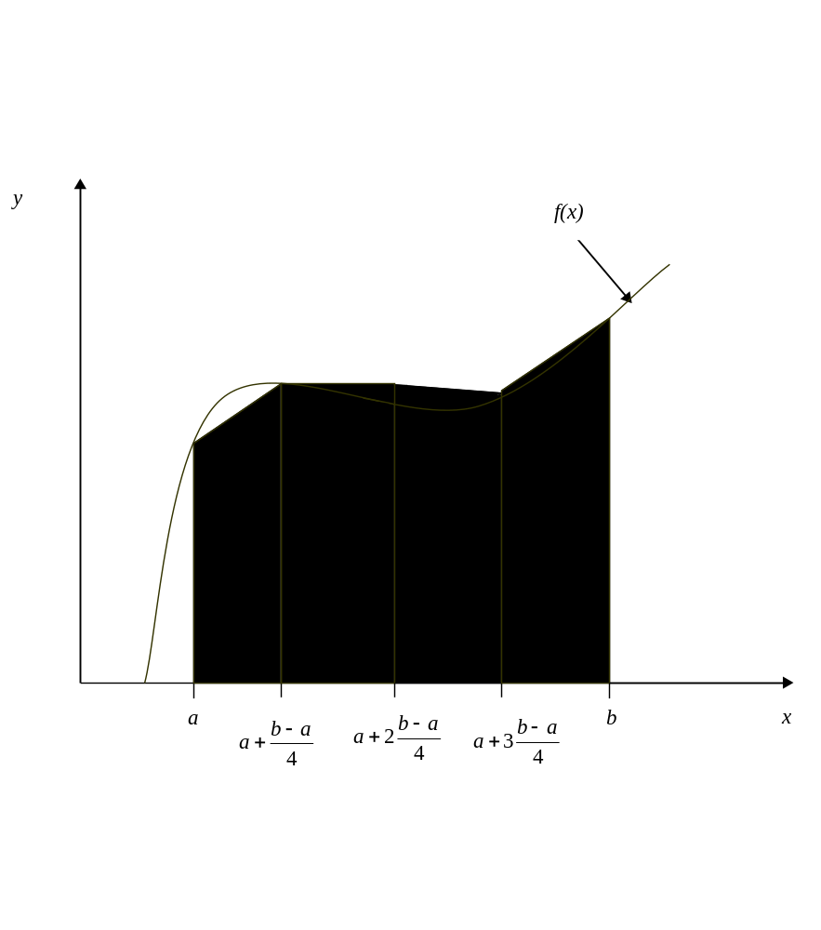
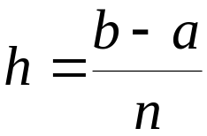
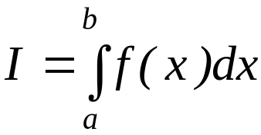
Multiple Segment Trapezoidal Rule
Divide into equal segments as shown in Figure 4. Then the width of each segment is:
The integral I is:
Figure 4: Multiple (n=4) Segment Trapezoidal Rule

Slide 15
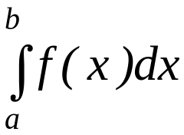
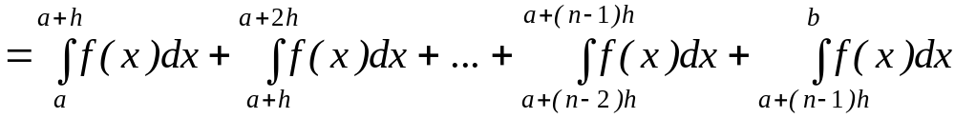
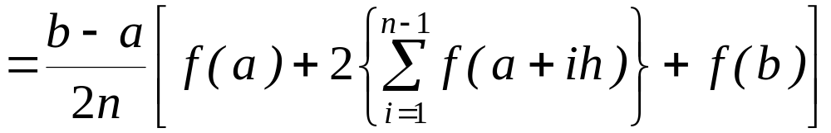
Multiple Segment Trapezoidal Rule
The integral I can be broken into h integrals as:
Applying Trapezoidal rule on each segment gives:

Slide 16
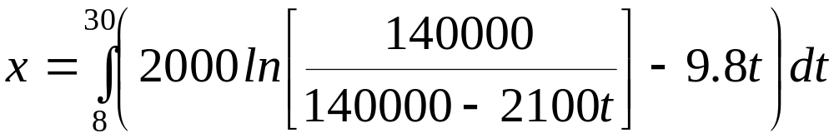
Example 2
The vertical distance covered by a rocket from 8 to 30 seconds is given by:
a) Use two-segment Trapezoidal rule to find the distance covered.
b) Find the true error, for part (a).
c) Find the absolute relative true error, for part (a).

Slide 17
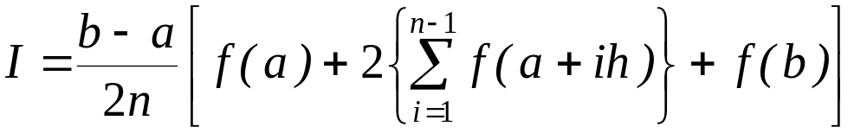



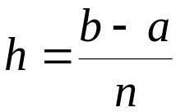
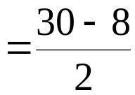

Solution
a) The solution using 2-segment Trapezoidal rule is

Slide 18
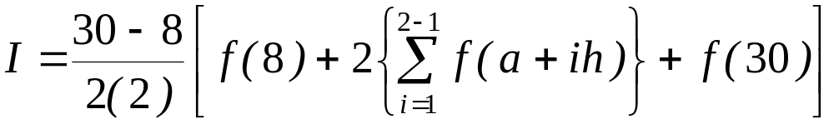
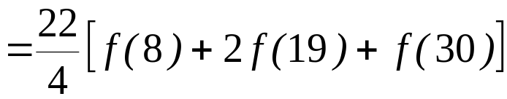
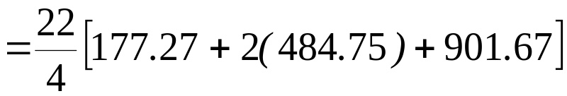

Solution (cont)
Then:

Slide 19
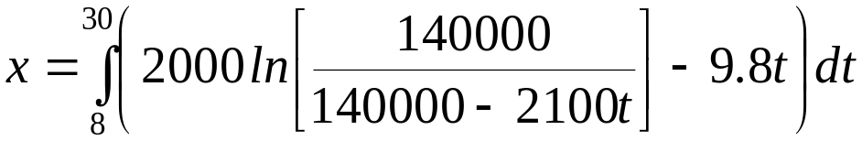


Solution (cont)
b) The exact value of the above integral is
so the true error is

Slide 20
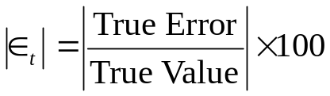
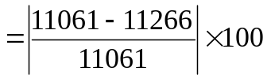

Solution (cont)
The absolute relative true error,
, would be

Slide 21


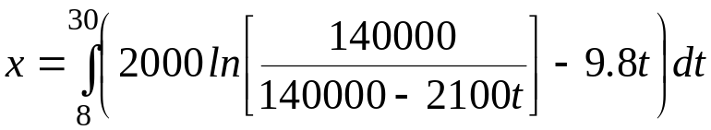
Solution (cont)
Table 1 gives the values obtained using multiple segment Trapezoidal rule for
n | Value | E_{t}
1 | 11868 | -807 | 7.296 | ---
2 | 11266 | -205 | 1.853 | 5.343
3 | 11153 | -91.4 | 0.8265 | 1.019
4 | 11113 | -51.5 | 0.4655 | 0.3594
5 | 11094 | -33.0 | 0.2981 | 0.1669
6 | 11084 | -22.9 | 0.2070 | 0.09082
7 | 11078 | -16.8 | 0.1521 | 0.05482
8 | 11074 | -12.9 | 0.1165 | 0.03560
Exact Value=11061 m
Table 1: Multiple Segment Trapezoidal Rule Values

Slide 22
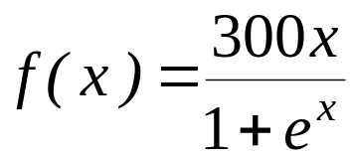


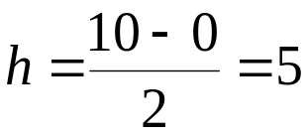
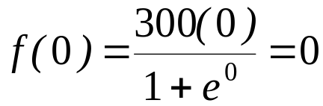
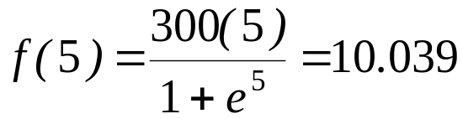
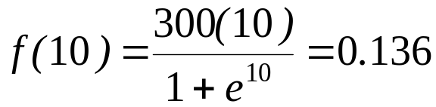
Example 3
Use Multiple Segment Trapezoidal Rule to find the area under the curve
from
to
Using two segments, we get
and

Slide 23
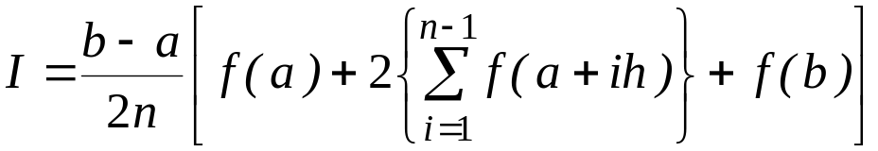
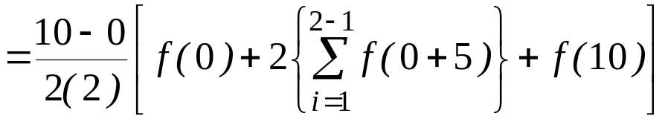
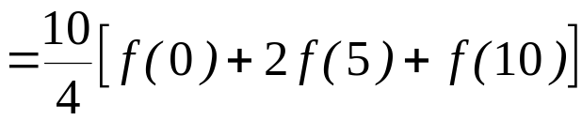
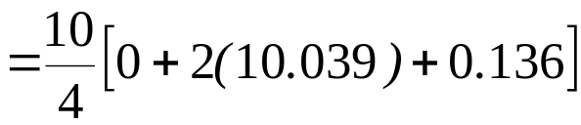

Solution
Then:

Slide 24
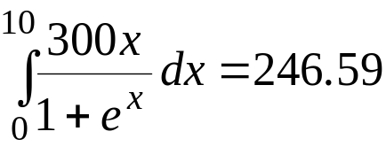
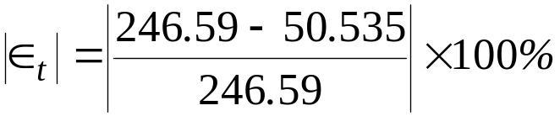

Solution (cont)
So what is the true value of this integral?
Making the absolute relative true error:

Slide 25
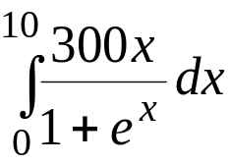


Solution (cont)
Table 2: Values obtained using Multiple Segment Trapezoidal Rule for:
n | Approximate Value
1 | 0.681 | 245.91 | 99.724%
2 | 50.535 | 196.05 | 79.505%
4 | 170.61 | 75.978 | 30.812%
8 | 227.04 | 19.546 | 7.927%
16 | 241.70 | 4.887 | 1.982%
32 | 245.37 | 1.222 | 0.495%
64 | 246.28 | 0.305 | 0.124%

Slide 26





Error in Multiple Segment
Trapezoidal Rule
The true error for a single segment Trapezoidal rule is given by:
where
is some point in
What is the error, then in the multiple segment Trapezoidal rule? It will be simply the sum of the errors from each segment, where the error in each segment is that of the single segment Trapezoidal rule.
The error in each segment is

Slide 27



Error in Multiple Segment
Trapezoidal Rule
Similarly:
It then follows that:

Slide 28






Error in Multiple Segment
Trapezoidal Rule
Hence the total error in multiple segment Trapezoidal rule is
The term
is an approximate average value of the
Hence:

Slide 29




Error in Multiple Segment
Trapezoidal Rule
Below is the table for the integral
as a function of the number of segments. You can visualize that as the number of segments are doubled, the true error gets approximately quartered.
n | Value
2 | 11266 | -205 | 1.854 | 5.343
4 | 11113 | -51.5 | 0.4655 | 0.3594
8 | 11074 | -12.9 | 0.1165 | 0.03560
16 | 11065 | -3.22 | 0.02913 | 0.00401

Slide 30
THE END

